Slide 1
CSE 331
Automata and computability
Lecture 1
Summer 2026

Slide 2



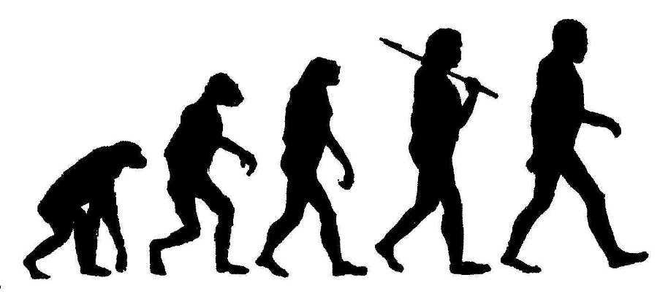
Learning goals

Slide 3
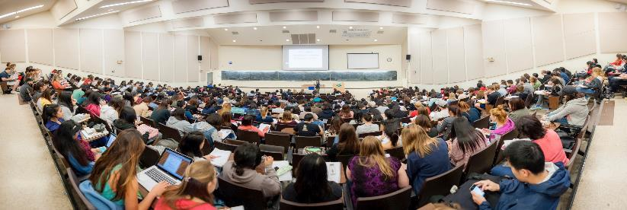
Introductions

Slide 4
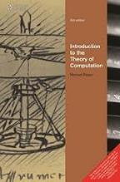
Logistics
Homework: 2 (one HW before mid, one HW after mid)
In-class: Group discussion + polls ; Read book first
Discussion section: more examples, homework warmup
Exams: Midterm, Apr 2, 2026 8:30 AM - 10:30 AM
Final Exam, May 16, 2026 8:30 AM - 10:30 AM
Google Classroom: Homework submission
Google Classroom : Announcements and Q&A.
Consultation: with me (check consultation routine).

Slide 5
Grading
Your final grade has 4 components
Final exam: 40%
Midterms: 30%
Quiz: 20%
Homework: 10% (Both of the HW will be counted)

Slide 6
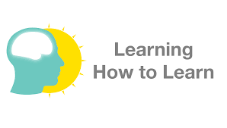
How to excel
Prepare ahead of class
  Read assigned sections, read homework questions
Engage in class
  Discuss questions with your neighbors (when we are in person), look for (counter) examples
  Go over wrong choices too!
Reinforce after class
  Briefly summarize what you learned
Start homework early
  Tackle problems together: brainstorm, plan, and solve together
Seek help and seek to help others, with integrity

Slide 7
How to excel with integrity
It's an integrity violation to…
Ask others to give you specific HW or test answers
Share your answers on HW or test
Work on HW with anyone other than your HW partners
Search the internet or other resources not provided for the class for HW solutions
Share answers or notes while taking an exam
This not a complete list … you are responsible for knowing and following the guidelines Academic integrity violations will be taken seriously and reported immediately

Slide 8
Homework
Homework is 10% of your grade
The main goal of homework is to help you learn the material in your own pace
Exams are going to be VERY SIMILAR to homework problems, so it is better for you to think on these problems when you have time, and not during the exam

Slide 9
Homework and AI
It is forbidden to use ChatGPT or similar tools for homework
If we catch students who use these, or cheat in any other way, they will be reported to the academic integrity review board

Slide 10
Participation
We need to maintain 70% of the attendance in class according to university policy to sit for final exam
In class we will have questions and follow-up discussions which will help you understand concepts better

Slide 11
CSE 331's big questions
What problems are computers capable of solving?
What resources are needed to solve a problem?
Are some problems harder than others?
Making a decision or computing a value
based on some input

Slide 12
Questions about algorithms
Are they correct (for given specification)?
Is there a better approach to solving the same problem?
Does each problem have a solution?
If so, can that solution be found by an algorithm?

Slide 13
Questions about algorithms
Are they correct (for given specification)?
CSE230: Discrete Math
Is there a better approach to solving the same problem?
CSE 221: Algorithms, Complexity theory
Does each problem have a solution?
CSE 331: Automata and Computability
If so, can that solution be found by an algorithm?
CSE 331: Automata and Computability

Slide 14


Activity
Goal: find treasure hidden somewhere in grid. Describe an algorithm for each robot.
Do you need to assume anything?
Do you need to keep track of any information?
Robot 1: can move North, East, West, South.
Robot 2: can move in four diagonal directions.

Slide 15
Computer = algorithm?
Your experience: Java, Python, C, etc.
Other computer models:
  Quantum computers
  DNA computation
  Supercomputers / Datacenters with parallelized and distributed computation
  Power-sensitive computation for mobile
  Embedded circuits
Different contexts call for different algorithms + different performance constraints

Slide 16
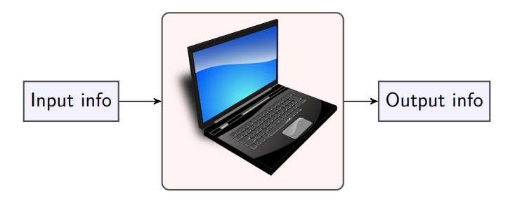
What is a computer/computation/algorithm?

Slide 17
Bird's eye view of CSE 331
Pick a model of computation
Study what problems it can solve
Prove its limits

Slide 18
Bird's eye view
Classification: is input of type A or not?
e.g. is n prime? is list sorted?
Computation: for specific input, what value should I output?
e.g. what's min cost of Hamiltonian tour?
Pick a model of computation
Study what problems it can solve
Prove its limits

Slide 19
Bird's eye view
Classification: is input of type A or not?
Decision problem
Computation: for specific input, what value should I output?
Function problem
Pick a model of computation
Study what problems it can solve
Prove its limits

Slide 20
Bird's eye view
Classification: is input of type A or not?
Decision problem
Computation: for specific input, what value should I output?
Function problem
Pick a model of computation
Study what problems it can solve
Prove its limits

Slide 21
Bird's eye view
Classification: is input of type A or not?
Decision problem
{ w | w is of type A}
PRIME = { 2, 3, 5, 7, … }
SORTED = { <1,3>, <-1, 8, 17> …}
Decision problems are coded by sets of strings
Pick a model of computation
Study what problems it can solve
Prove its limits

Slide 22
Models of computation
Finite automata
Context-free grammars
Turing machines

Slide 23
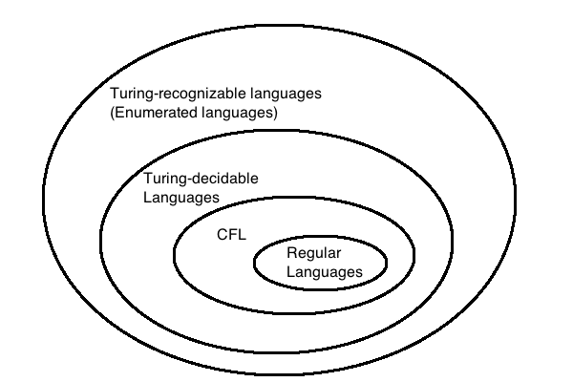
Models of computation
Finite automata
Context-free grammars
Turing machines

Slide 24
So let's get going ☺
Textbook reference: Chapter 0, Section 1.1
First topic: Automata (DFA)

Slide 25
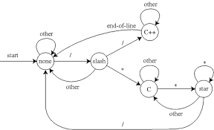
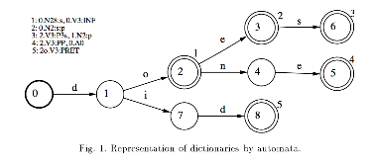
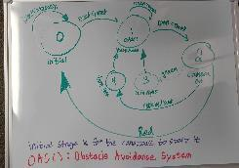
Automata
Code input as strings
Model memory using states
Text processing
  grep, regexp
Natural language processing
Hardware design
  Moore machines
Controllers / Robots
    SPIS!

Slide 26
Example: subway turnstile
A subway turnstile is locked until a token is entered, at which point it unlocks in response to a single push, after which it locks again.
When you approach the turnstile, will it open?
How can we model this problem as a classification question?

Slide 27
Example: subway turnstile
A subway turnstile is locked until a token is entered, at which point it unlocks in response to a single push, after which it locks again.
When you approach the turnstile, will it open?
How can we model this problem?
Alphabet: {token entered, push}
Input: sequence of moves
Language: {sequences of moves giving unlocked gate}

Slide 28
Example: subway turnstile
A subway turnstile is locked until a token is entered, at which point it unlocks in response to a single push, after which it locks again.
t
Locked
Unlocked
p

Slide 29
Example: subway turnstile
What happens if the turnstile is pushed while locked?
Transition to unlocked
Stay locked
Send error message
None of the above
A subway turnstile is locked until a token is entered, at which point it unlocks in response to a single push, after which it locks again.
t
Locked
Unlocked
p

Slide 30
Example: subway turnstile
A subway turnstile is locked until a token is entered, at which point it unlocks in response to a single push, after which it locks again.
t
p
t
Locked
Unlocked
p

Slide 31
Example: subway turnstile
What's the initial state of the turnstile?
Locked
Unlocked
A subway turnstile is locked until a token is entered, at which point it unlocks in response to a single push, after which it locks again.
t
p
t
Locked
Unlocked
p

Slide 32
Example: subway turnstile
A subway turnstile is locked until a token is entered, at which point it unlocks in response to a single push, after which it locks again.
t
p
t
Locked
Unlocked
p

Slide 33
Finite automata and decision problems
Decision problem "is w of type A?" coded by the set
{ w | w is of type A}
A problem is solved by a finite automaton if
the machine accepts all w for which the answer is yes and rejects all w for which the answer is no
Those inputs for which the answer is "yes"

Slide 34
Example: subway turnstile
Problem: Which sequences of moves will unlock turnstile?
Alphabet: {t, p}
Language: {sequences of moves giving unlocked gate} = { t, ppt, …}
= {strings over alphabet that, when input to this automaton, end in Unlocked state}
p
t
t
Locked
Unlocked
p

Slide 35
What is an alphabet?
An alphabet, denoted by Σ, is a finite, non-empty set of symbols.
Σ = {a, b}
Unary alphabet Σ = {1}
Binary alphabet Σ = {0, 1}
English alphabet Σ = {a, . . . , z, A, . . . , Z}
Alphanumeric alphabet Σ = {a-z, A-Z, 0-9}

Slide 36
Powers of an alphabet
Σ = Some alphabet
Σ^{k} = Set of all strings of length k over Σ
Σ*= Σ⁰ ∪ Σ¹ ∪ Σ² ∪ · · · = Set of all strings over Σ. Σ* is the universal set of all strings
Σ⁺ = Σ¹ ∪ Σ² ∪ Σ³ ∪ · · · = Set of nonempty strings over Σ

Slide 37
What is a string?
A string or word is a finite sequence of symbols chosen from Σ.
A string x ∈ Σ*. An empty string is denoted by ε .
|x| = length of string x
n_{σ}(x) = #occurrences of symbol σ ∈ Σ in the string x

Slide 38
Examples of string
x = abaaabb from Σ = {a, b}
x = 111 from Σ = {0, 1}
x = ε from Σ = {a, . . . , z, A, . . . , Z}
x = Bond007 from Σ = {a − z, A − Z, 0 − 9}

Slide 39
What is a language?
A language over Σ is a subset of Σ*
The empty language φ.
{ε, a, aab} - a finite language.
Language of palindromes over {a, b}
{x ∈ {a, b}* | n_{a}(x) > n_{b}(x)}. {x ∈ {a, b}∗ | |x| ≥ 2 and x begins and ends with b}

Slide 40
Vocabulary review Sipser p. 14
{ a,b,c,d,e } The set whose elements are a,b,c,d,e
{ a,b }* The set of finite strings over a,b
    Includes empty string ε
    Includes a, aa, aaa
    Includes b, bb, bbb
    Includes ab, ababab, aaaaaaabbb
    Does not include infinite sequences of a's and b's
    Has infinitely many different elements
| ababab | = 6 The length of the string ababab is 6
| { a,b,c,d,e } | = 5 The size of the set {a,b,c,d,e} is 5
A language (over alphabet Σ) is a set of strings (over Σ)

Slide 41
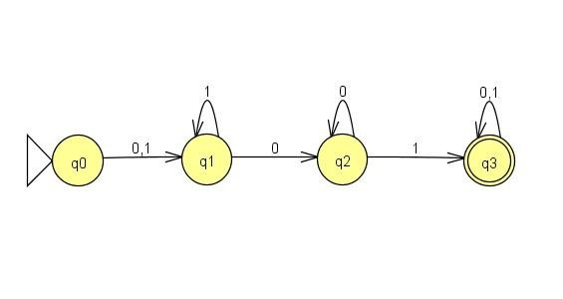
Deterministic Finite automaton Sipser p. 34, 40
Input: finite string over a fixed alphabet
Output: "accept" or "reject"
The language recognized by the machine is the set of strings it accepts.
Start state
(triangle/arrow)
Accept state
(double circle)

Slide 42
Deterministic Finite automaton Sipser p. 34, 40
Computation of the machine on an input string
  Sequence of states in the machine, starting with the initial state, determined by transitions of the machine as it reads additional input symbols.
How does the computation of the machine on a string relate to whether the string is accepted by the machine?
If the first state in the computation is an accept state, the string is accepted.
If any state in the computation is an accept state, the string is accepted.
If the last state in the computation is an accept state, the string is accepted.
If all of the states in the computation are accept states, the string is accepted.
E. None of the above

Slide 43
Finite automaton
Input: finite string over a fixed alphabet
Output: "accept" or "reject"
Example input: 0001
Start state
(triangle/arrow)
Accept state
(double circle)

Slide 44
Finite automaton
Input: finite string over a fixed alphabet
Output: "accept" or "reject"
What is the computation of this machine on input 110?
q1, q1, q0 B. q1, q1, q2
C. q0, q1, q2, q3 D. q0, q1, q1, q2
E. None of the above

Slide 45
Finite automaton
Input: finite string over a fixed alphabet
Output: "accept" or "reject"
Is the empty string accepted?
Is the string 001 accepted?
Is the string 0011010101010 accepted?
What is the language recognized by this machine?

Slide 46
For next time
Set up course tools: Classroom
Read all the questions + relevant examples in the book
Read the book section (which section to read will be provided) before the class

